Slide 1

PROMOTION
SUCCESS
ANALYSIS

Slide 2
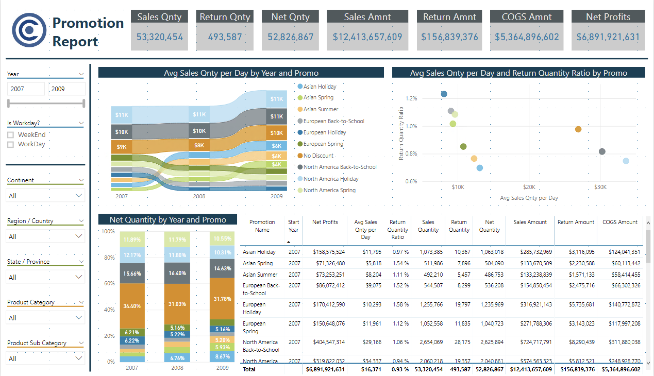
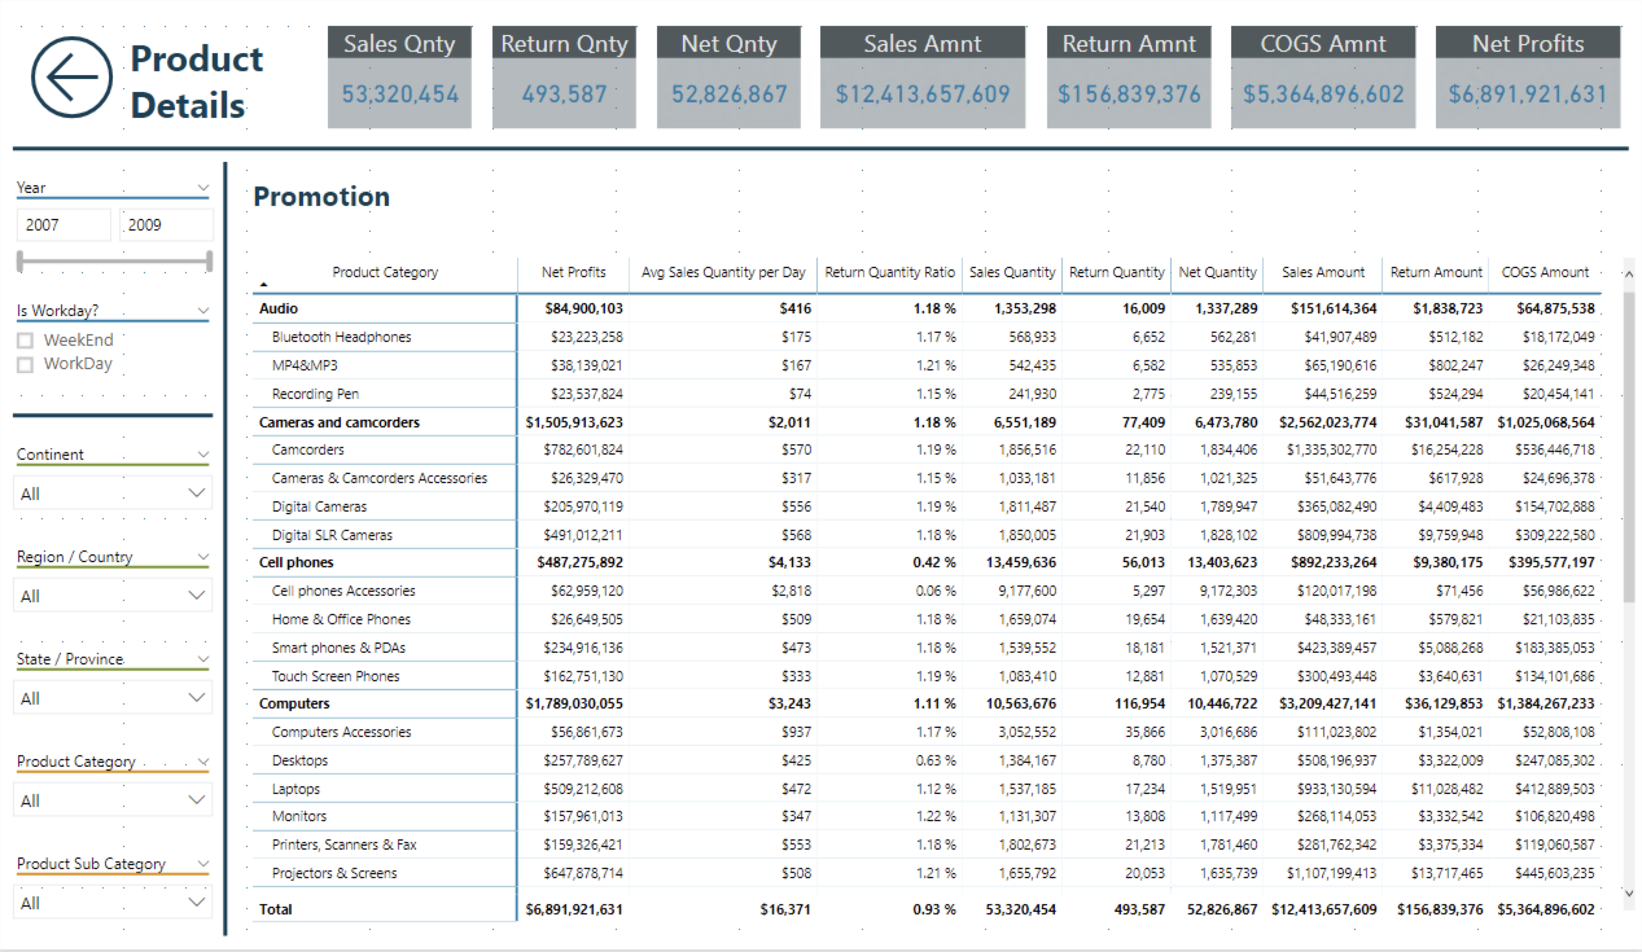
Requirements
KPI’s
Average Sales per Day
Product Return Quantity Ratio
Outputs
Report
Promotion Analysis
Product Detail Breakouts
Dashboard
Web and Mobile views
Presentation Overview

Slide 3
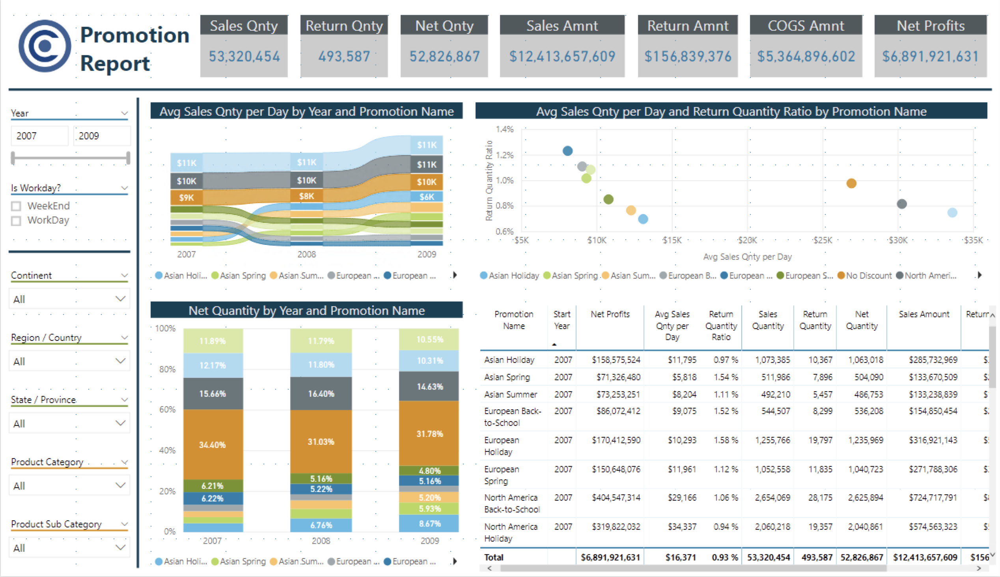

Slide 5
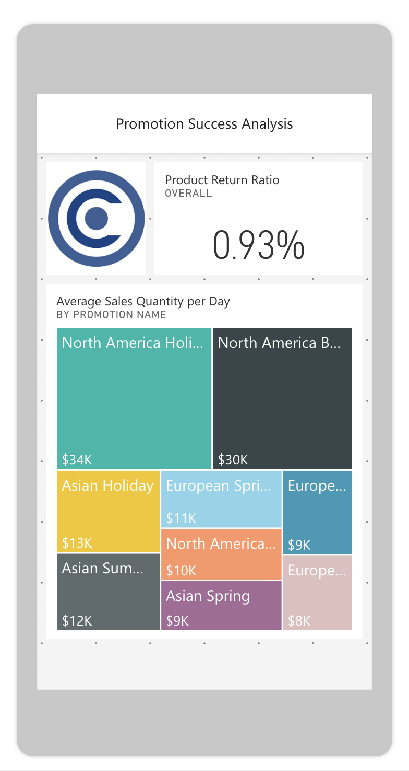
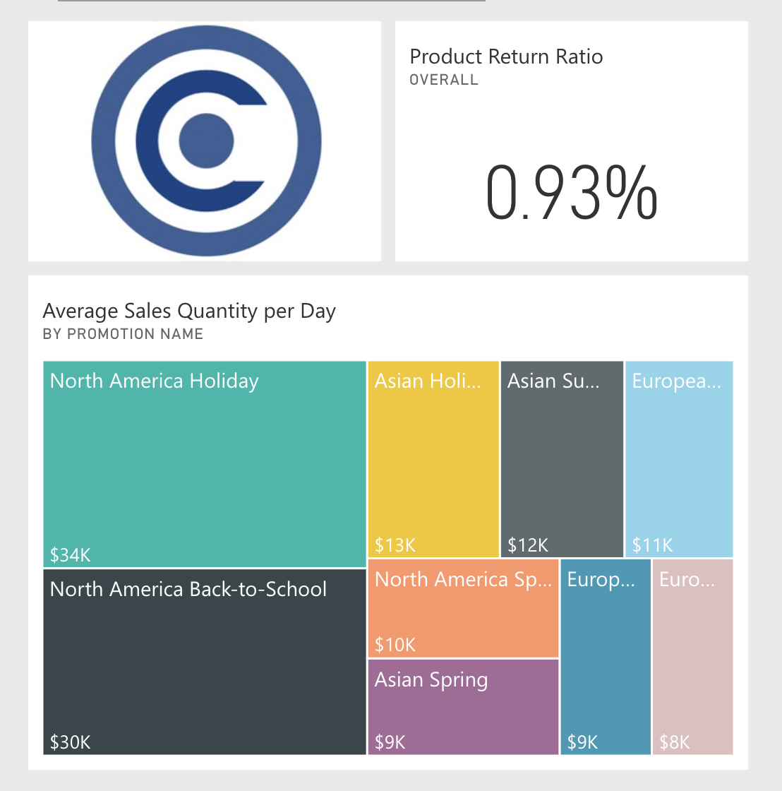
Dashboard Views
WEB
MOBILE

Slide 6
Conclusions
Key Findings
NA Holiday promo had highest avg. sales quantity per day.
Asian Holiday promo had the lowest product return ratio.
NA Holiday promo had the highest avg. sales quantity per day compared to product return ratio.
Most promos did not perform better than a No Promo period– all of them except NA Holiday and NA Back-to-School promos had lower avg. sales quantity per day.
Recommendations
NA Holiday and NA Back-to-school promos were by far the clear winners; additional research into promotion seasons specific to the Asian and European markets may be warranted.

